Slide 1
SMSF & Crypto Currency - Good or Bad ! Don't Care - But how do I audit them?
Manoj Abichandani SMSF Specialist (UNSW)

Slide 2
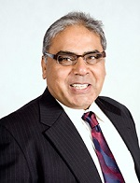
Our Speaker Today
Manoj Abichandani
B. Bus. (UTS), Tax Agent
CTA, SMSF Specialist (UNSW)
Manoj has worked in a Specialist SMSF CPA Firm for 28 years advising over 600 funds on various aspects of SMSF.
Currently he works as a SMSF Technical Director for Deed Dot Com Dot Au Pty Ltd as a trainer and helps the solicitor in updating their SMSF Trust Deed.
He has written Australia’s first online SMSF Audit Software where 995 + SMSF Auditors initiated over 82,000 SMSF audits in the past year.

Slide 3
How to audit an SMSF’s who have invested Crypto Currency
What is Crypto Currency
Super Law Issues in Crypto Currency investments
ASIC and ATO’s concerns
How to audit these investments

Slide 4
House Keeping - Audio
If Computer sound is not audio able
Phone the number on your panel
Enter Access Code

Slide 5
House Keeping – Hand Out
Copy of this Presentation can be downloaded
From the Panel

Slide 6
House Keeping – Questions on this Presentation
If you have any Questions on this Presentation
Type in your questions in the panel
Speaker will answer all your questions
after the presentation

Slide 7
Legal & Financial Disclaimer & Disclosure
In providing the below information, neither Manoj Abichandani (presenter) or an employee of Deed Dot Com Dot Au Pty Ltd is providing any financial or Legal advice as any Financial advice is based on the information provided by you with regard to your financial needs and objectives. The information below is intended to provide only broad, general guidelines which may be helpful in assessing and making decisions about financial products and general information which is available elsewhere that may help meet your financial needs and objectives. This material may also contain general educational topics about investing, legal and financial matters. It is most important that you understand that your actual experience will differ from these illustrations and examples.
That is why you should consult an appropriately qualified financial planner, legal advisor or Estate planner, who can assess your situation with updated data and assumptions on a periodic basis. Information provided here is not intended to be investment advice or a projection of future investment performance. No one can foresee the future and, it is not a projection of the potential return of any investment, nor is it a projection of future inflation rates or the state of the world or domestic economy. You should seek the guidance of a financial or investment professional before proceeding with any investment decision or any super contribution or set up Decision. Our examples and illustration does not contain your income tax calculations and legal concepts; it does not constitute tax or legal Advice. These illustration may require the guidance of a tax, legal or accounting adviser.
In creating the illustration certain assumptions were made with respect to investment returns, the economy, and home loan interest rates . The reports and graphics included are directly dependent on the quality and the accuracy of the data and assumptions (including rates of return and future interest rates) . Where future rates of return are assumed, these returns do not reflect the fees and charges associated with Investments, which would reduce the results. You are encouraged to review and consider performance information, which you can request from your investment professional and other securities advisor who may recommended asset/s that may be referenced in this material when assuming any future rates of return for any super contributions & investment.
Keep in mind that past performance is not a guarantee of future results. A prospectus or PDS must be read carefully when considering any investment in securities or super contribution in a fund.
No liability is assumed resulting from the use of the information contained in this financial presentation and the examples used Responsibilities for financial decisions are exclusively in hand of the viewer and not in hands of the presenter.
Notes:
May require more than one slide

Slide 8
Crypto Currency – In Nut shell
Digital or Fool’s Gold
Exceptional returns
$10,000 of Bitcoin in 2011 is worth $30 million today
SMSF are investing in Crypto Currency
Crypto are not regulated - barter system without borders
Audit of SMSF will need to be done and these assets valued
Challenges ahead of SMSF Auditors
Notes:
May require more than one slide

Slide 9
Current Situation
US Will Bring 30 Countries Together to Combat Illicit Use of Crypto, Says Biden
A week ago China, declared all cryptocurrency transactions illegal
SEC wants the power to regulate crypto assets as securities, arguing that the sector is rife with fraud, scams and abuses.
China, which is well down the tracks of issuing a digital yuan – it has been engaged in an advanced pilot program – had previously banned crypto mining, which is extremely energy-intensive.
recent hacking of Coinbase, one of the largest digital assets exchanges, which resulted in the cryptocurrencies of more than 6000 customers stolen
The UK set up a taskforce earlier this year to explore the potential for a “Britcoin,”

Slide 10
Level playing field
Promoters of crypto assets today see themselves as disrupters of the establishment
Establishment sees digital currencies and the block chain technologies that underpin them as a pathway to a more efficient, innovative and inclusive financial system
Role of existing institutions and the extent to which privately-issued crypto assets should be allowed to exist and, if they are allowed, how they are regulated – will be important.

Slide 11
What is Crypto currency…
Future of Money – What can you buy with Bitcoin ?
Or is it an Investment ?
Ponzi Scheme – a bubble
Rise of Crypto after GFC
Developed anonymously, Decentralised – Block chain – Publically viewable ledger
Limited in supply (Only 21 Million Coins) and Marketed as digital gold
Market capitalisation of nearly US$2 Trillion
Generated Life changing profits for many….
Notes:
May require more than one slide

Slide 12
Block Chain - Satoshi Nakamoto
Like Google Drive – all users see the same data – but excel sheet is in millions of data centres – updated on real time – Saved in Blocks – Block chain
All updates are in real time – identical data on all computers
A mass-distributed, single and identical public ledger
Transactions are incorruptible and irreversible – saved in Blocks
Transactions are grouped and added to the public ledger in blocks (every 10 minutes – time stamping)
Blocks cannot be controlled by any single entity
Notes:
May require more than one slide

Slide 13
How to Transact in Crypto
You need a Wallet
Wallet is a software program
You can download this program and have a wallet
Wallet has your “Public Key” and “Private Key”
Public Key – Receive Private Key – Pay
Both Keys are digitally related
Private Key can be transformed to Public Key – but reverse is impossible
Address is a short version of the public key
Every time you receive – a new address is created in your wallet
Private Key is like your password
wallet also keeps track of the transactions made, with time stamps on each transaction
9ACHNa6Q4Jz2uvNExL497mE43ikXhwF6kZm
Notes:
May require more than one slide

Slide 14
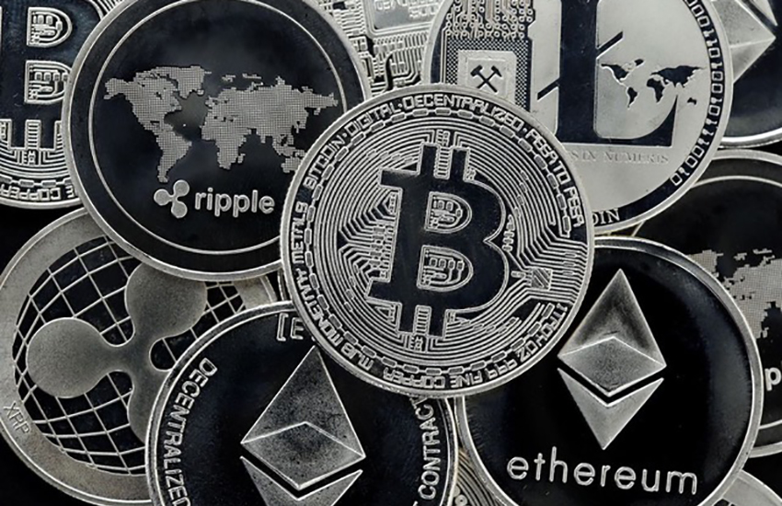
Issues with Crypto currency
FOMO
Speculation of the highest order
Governance and regulatory issues with exchanges
Exchanges like “Coinbase” has over 30 Million accounts
Stories of exponential profits
Lack of trust people have in Society – Politicians / Banks / financial Leaders – aftermath of Royal Commission
Crypto currency exists outside the financial system
All warnings are from mainstream finance community
Value: A Da Vinci Painting was sold for $450 Million in November 2017
Notes:
May require more than one slide

Slide 15
Crypto currency in your SMSF
Diversification – Investment Strategy – Prudent Trustees
“Crypto Storage Accounts” - with a certificate are replacing “Digital Wallets”
Agents / brokers issue Invoices in the name of the Trustees – details of the digital wallet address
Auditors can search the address – obtain ledger transactions on Quantity as on 30th June
Market Price as on 30th June 2021 will be the market value (What about price on date of audit - Subsequent events)
Notes:
May require more than one slide

Slide 16
Valuation of Crypto currency
Market Value as on 30th June or – on date of signing the audit report
Auditing Standard ASA 560 - obtain sufficient evidence of all events up to the date of the auditor’s report
Subsequent events have occurred - sales of investments - significant adjustments to investment values
A material event may require appropriate disclosure and amendments to Part A of the audit report
Notes:
May require more than one slide

Slide 17
Fraud risks in SMSF due to Crypto currency
Hackers may be able to access clients wallets (SMSF asset)
Delays in recording of information in a decentralized ledger system
Either doubling of transactions or becoming Zero is possible
Management letter must alert Trustees of possible Fraud
Notes:
May require more than one slide

Slide 18
Financial Advice to SMSF on Crypto
Crypto is NOT a financial product
Fake Crypto exchange websites
No underlying asset or government regulation
If the client wants to invest - Best interests duty
ATO Guidance paper - is neither money or foreign currency
Notes:
May require more than one slide

Slide 19
Sole Purpose test…
Permitted by the trust deed
Included In the investment strategy
Crypto currency is being used for payments of illegal activities
Trading in Crypto – Can be a business
Charge over the asset
SIS Regulation 13.14
Crypto are in wallets which can only be in individual names
Trustee Dies – password with other trustees or beneficiaries
Declaration of Trust – holding Fund assets
Notes:
May require more than one slide

Slide 20
Future issues identified Crypto Investment
Can Crypto owned by an SMSF be used to purchase other SMSF assets – Like Property
Can Crypto be accepted as consideration for the sale of an SMSF asset – Like Property
Crypto pays no income – Is the trustee acting in the best interests of the members?
What about Gold or Mining shares or loss making properties
Can employers make contributions for a member in Crypto currency
Notes:
May require more than one slide

Slide 21
ASIC and ATO…
TD 2014 /25 - Does not satisfy the ordinary definition of money - It is not currency
TD 2014 /26 - A property within the meaning of paragraph 108-5(1)(a).
- Crypto currency is a CGT asset.
Overseas transactions over $10,000 must be reported AUSTRAC
Mining of Crypto – Could be considered as a business
Notes:
May require more than one slide

Slide 22
CGT Event
Each cryptocurrency is a separate asset for CGT purposes. When your client disposes of one cryptocurrency to acquire another, they are disposing of one CGT asset and acquiring another CGT asset.
If your client holds cryptocurrency for 12 months or more, they may be entitled to a 50% CGT discount to reduce any capital gains made when they dispose of it.
If they are in business, the trading stock rules apply, rather than the CGT rules. If the disposal of cryptocurrency is part of their business, then:
the cost of acquiring cryptocurrency held as trading stock is deductible
profits made are assessable as ordinary income, not as a capital gain.

Slide 23
SMSF Audit with Crypto Investment
Wallets do not have “SMSF title” on it – No title
Ownership issues
Declaration of Trust
SIS 4.09A – Separation of Assets
Every transaction has a new address – Wallet can be difficult to audit
Section 66 – SMSF cannot purchase Crypto from a related party
In-specie contribution are not allowed (Only Shares and BRP exempted)
Notes:
May require more than one slide

Slide 24
SMSF Audit with Crypto Investment
3. SIS R 4.09 Investment Strategy – Investment in Crypto currency bitcoin needs to be reflected
Not cash or a collectable
Consider each year
4. Trust Deed – Trustee allowed to invest in Crypto currency
5. Declaration that Private Key is safe & secure – minutes for each purchase or sale – were all trustees involved in decision making
6. Pensions must be made in cash – Lump Sums can be in-specie – Taxable CGT event
Notes:
May require more than one slide

Slide 25
SMSF Auditor : Fund with Crypto Investment
Auditors can view Public Ledger with a Public Key – 3rd party verification is possible.
- Dates, transactions and running balance is available
- Very messy ledgers
- Time to audit will increase
Audit risk and will PI insurance cover the audit
Audit checklist – working papers to prove that you done your job well
If significant % of fund assets are invested – comments in Management Letter will need to be made
Trust deed requirement
Separation of assets – personal Vs SMSF wallet
Sole Purpose test – Contraventions – if trustee benefits personally
SIS Act Section 52B (2) (b) Trustees prudent person responsibility
Notes:
May require more than one slide

Slide 26
For further Enquires
please visit our websites:
www.trustdeed.com.au
www.onlinesmsfaudit.com.au
www.justsign.com.au
and chat with our agent.
Alternatively, you - contact us 0296844199 or
Email us at
sales@trustdeed.com.au
sales@onlinesmsfaudit.com.au
sales@justsign.com.au

